Slide 1
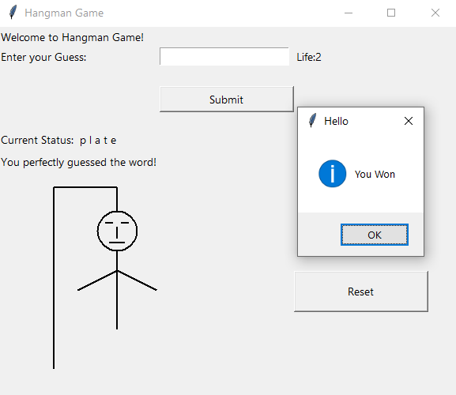
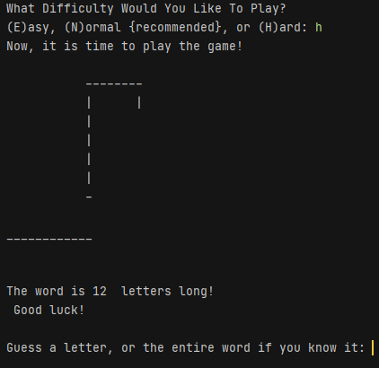
Hangman GUI and Difficulties hangman with a twist for different levels of players
Grahm Jones

